Slide 1
Recommend a bank for investment purpose – From risk management perspective
112352014 劉冠銘

Slide 2
Abstract
This report will compare the financial reports and quantitative indicators of the following three banks:
Yuanta (元大)
E.SUN (玉山)

Slide 3
Yuanta - Introduction
Company Overview:
Yuanta Financial Holdings is a financial holding company with a focus on securities. It was formerly known as Fuhwa Financial Holding and became part of the Yuanta Group after completing the merger with Fuhwa Financial Holding in April 2007. The company's business scope encompasses securities, banking, futures, and life insurance. Yuanta has a history of proactive mergers and acquisitions to expand its business and asset base. In 2005, it acquired Fuhwa Financial Holding, followed by the acquisition of Polaris Securities in 2011, leading to a significant increase in Taiwan's brokerage market share, surpassing 14%. In 2013, it ventured into the life insurance sector by acquiring Taiwan International New York Life. The expansion continued in 2014 with the acquisition of DongYang Securities in South Korea. In March 2016, Yuanta expanded its banking operations through the acquisition of Ta Chong Bank. As of September 2022, the company's total assets reached 2.98 trillion New Taiwan Dollars, ranking 12th among the 16 financial holding companies in Taiwan and establishing itself as the largest financial holding company with a primary focus on securities in Taiwan.

Slide 4
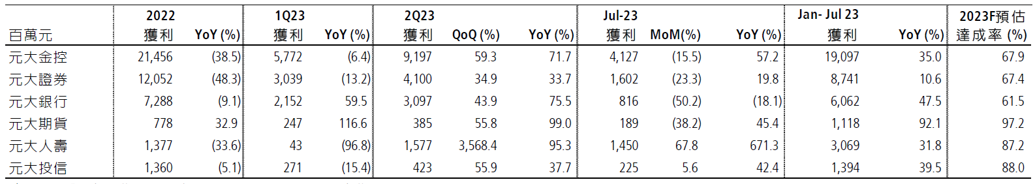
Yuanta – Financial Indicators
data ：凱基
From the chart, it can be observed that:
Yuanta Financial Holdings achieved a significant expansion in the year-on-year growth rate of after-tax net profit, reaching 35% in the first seven months. Notably, the banking sector contributed to this growth with a 48% increase in profits, driven by a 78% year-on-year growth in non-interest income and an 89% decrease in provisions for bad debts
The securities and futures segments also exhibited positive performance, with profits growing by 11% and 92%, respectively. Additionally, the life insurance sector contributed to overall growth with a 32% increase in profits.

Slide 5
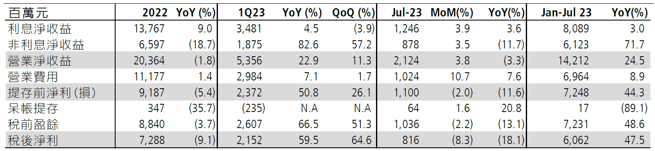
Yuanta – Financial Indicators
data ：凱基
From the chart, it can be observed that:
Yuanta's after-tax profit saw a 48% year-on-year increase in the first seven months, indicating a favorable overall business performance.
The primary non-investment income played a significant role in driving the profit growth by 72%. This may involve sources of income beyond investments, such as fees, commissions, and foreign exchange. From a risk management perspective, a detailed understanding of the individual components within non-investment income is essential to ensure sustainable growth and assess associated risks.
The substantial 89% decrease in provisions for bad debts indicates notable progress in the bank's bad debt management. This reduction suggests the effectiveness of risk management measures, leading to a decrease in credit risk.

Slide 6
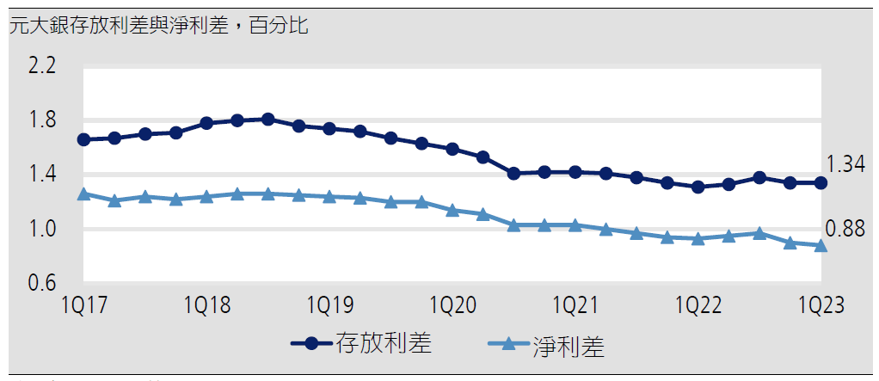
Yuanta – Financial Indicators
data ：TEJ
From the chart, it can be observed that:
In 1Q23, Yuanta Bank's net interest margin (NIM) decreased by 2 basis points to a historic low of 0.88%. This could suggest an increase in funding costs or pressure on income.

Slide 7
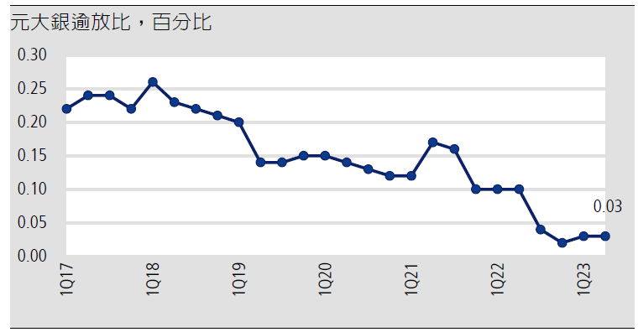
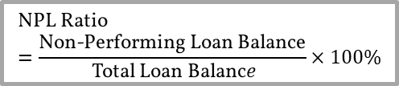
Yuanta – Financial Indicators
$$\text{NPL} \text{Ratio}=\frac{\text{Non}\text{−}\text{Performing} \text{Loan} \text{Balance}}{ \text{Total} \text{Loan} \text{Balanc}​e}×100\%$$
data ：TEJ
From the chart, it can be observed that:
Historically, Yuanta Bank's non-performing loan (NPL) ratio has shown a gradual decline, reaching only 3% in 1Q23. This ratio serves as an indicator to assess the effectiveness of the bank's credit risk management. A high NPL ratio may imply that the bank is exposed to significant credit risk, necessitating attention to risk control measures. Conversely, a low NPL ratio may indicate that the bank's loan portfolio is relatively secure. Therefore, based on the NPL ratio, it can be inferred that Yuanta Bank has a lower level of credit risk.

Slide 8
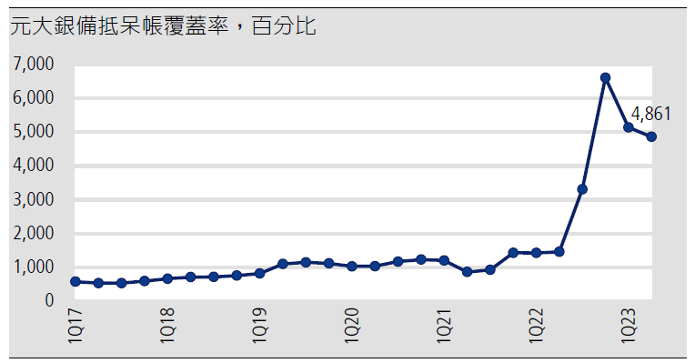
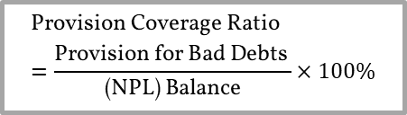
Yuanta – Financial Indicators
$$\text{Provision} \text{Coverage} \text{Ratio}=\frac{\text{Provision} \text{for} \text{Bad} \text{Debts} }{ \text{(}\text{NPL}\text{) }\text{Balance} ​}×100\%$$
data ：TEJ
From the chart, it can be observed that:
Looking at 1Q22, Yuanta's provision coverage ratio has gradually increased, reaching 486.1% in 1Q23. A high provision coverage ratio is generally considered a positive indicator of credit risk management. It suggests that the bank has strong preventive and coping capabilities against potential losses. On the contrary, a low provision coverage ratio might indicate that the bank may not be adequately prepared for potential credit risks, necessitating careful risk assessment and the strengthening of risk management measures. Therefore, it can be concluded that Yuanta has performed well in this credit risk management indicator.

Slide 9
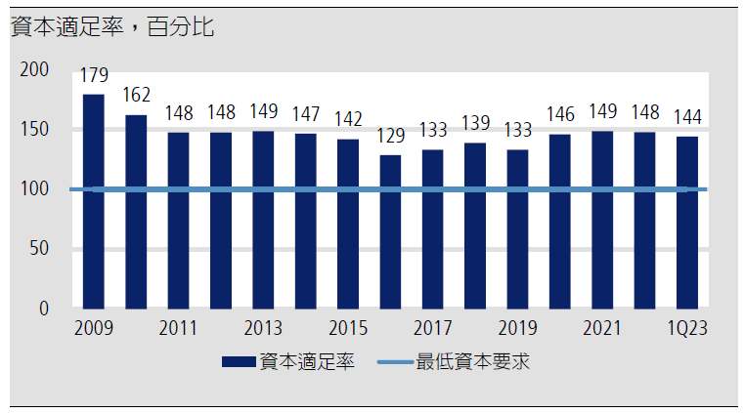
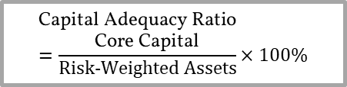
Yuanta – Financial Indicators
$$\text{Capital} \text{Adequacy} \text{Ratio}=\frac{\text{Core} \text{Capital}}{Risk−Weighted Assets​}×100\%$$
data ：TEJ
From the chart, it can be observed that:
Yuanta has consistently maintained a considerable distance from the minimum capital requirements, with a capital adequacy ratio of 14,400% in 1Q23. A high capital adequacy ratio indicates that the financial institution has ample capital available to address potential losses, thereby enhancing its financial robustness and resilience to risks. A low capital adequacy ratio might suggest that the financial institution is at risk and may need to increase capital or reduce risk assets. Therefore, it can be concluded that Yuanta has performed well in this credit risk management indicator.

Slide 10
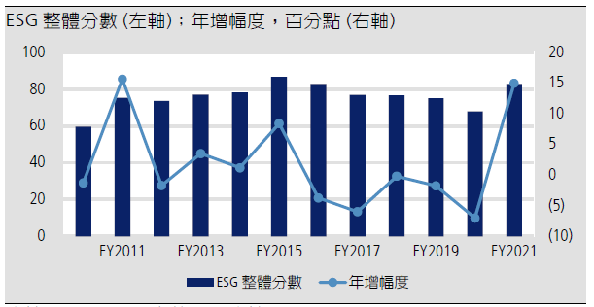
Yuanta – Financial Indicators
data ：Refinitiv、凱基
From the chart, it can be observed that:
The ESG score of Yuanta showed a considerable year-on-year increase in 2021. Although the reason may be attributed to a relatively lower performance in the previous period, an outstanding annual growth rate can also appeal to investors with a strong preference for ESG scores.

Slide 11
E.Sun – Introduction
Company Overview :
Established in 2002, E.Sun Financial Holdings has evolved into a medium-sized financial conglomerate with a primary focus on banking. As of 2017, its assets have grown to 2 trillion New Taiwan Dollars, ranking 12th among the 16 financial holding companies in Taiwan. Over the years, E.Sun Financial Holdings has transformed into a comprehensive financial service provider with a broad market footprint, spanning services from banking to securities and venture capital. In 2017, the banking segment contributed over 99% of the financial conglomerate's profits. E.Sun Financial Holdings has been actively expanding its domestic deposit and loan business as well as consumer finance services in recent years. Simultaneously, the company has extended its operations to mainland China, Cambodia, and Singapore, while venturing into digital finance 3.0, which includes online payments, cross-strait payment services, and mobile banking services.

Slide 12
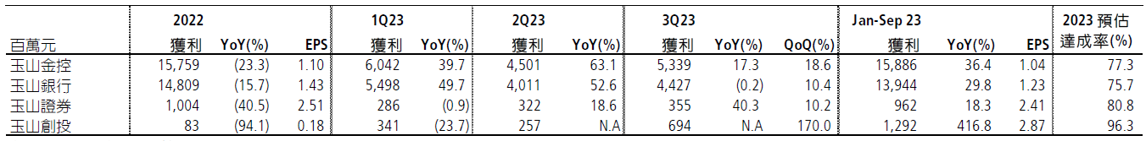
E.Sun – Financial Indicators
data：凱基
From the chart, it can be observed that:
The 3Q23 net profit after tax of 53.4 billion NT dollars reflects a year-on-year increase of 17% and a quarter-on-quarter increase of 19%. This may indicate the bank's adaptability to the economic environment and the effectiveness of its business strategies.
The primary securities segment experienced a year-on-year profit increase of 40%, and there is information suggesting a venture capital profit of 6.9 billion NT dollars. These figures indicate that the bank's investment division achieved robust performance during the quarter, particularly in the areas of securities and venture capital.
The bank's overall profit remained stable compared to the same period last year, suggesting that the bank's traditional business activities, such as loans and deposits, exhibited relatively consistent performance during this period.

Slide 13
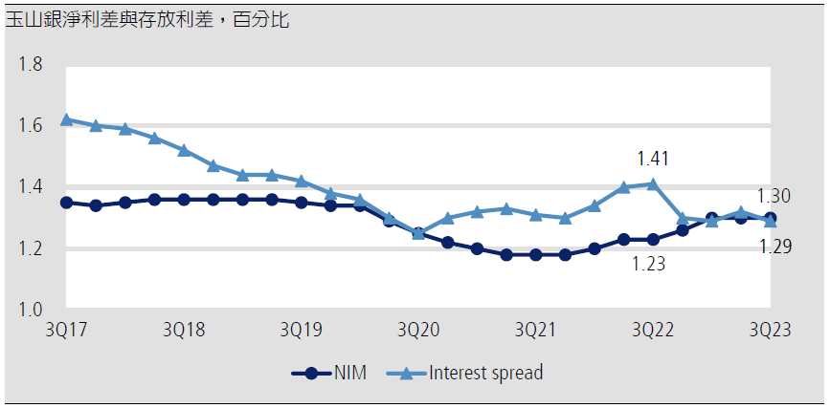
E.Sun – Financial Indicators
data ：凱基
From the chart, it can be observed that:
In 3Q23, E.Sun Bank's net interest margin remained stable at 1.3%, unchanged from the previous quarter. The consistent net interest margin suggests that the bank maintained a relatively stable position in terms of interest rates and funding costs during the quarter.
However, the interest spread on deposits decreased by 3 basis points to 1.29%, likely reflecting the impact of changes in the money market interest rates on the bank's deposit business. The increase in funding costs could be influenced by factors such as fluctuations in market interest rates and central bank policy adjustments.

Slide 14
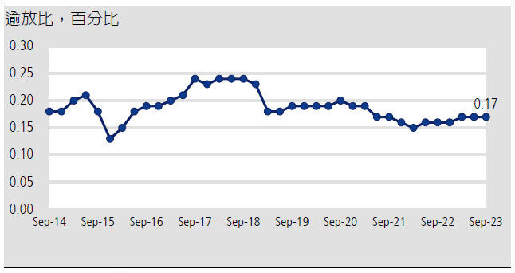
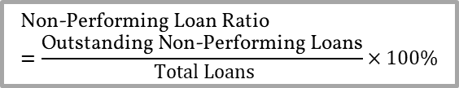
E.Sun – Financial Indicators
$$\text{Non}\text{−}\text{Performing} \text{Loan} \text{Ratio}=\frac{\text{Outstanding} \text{Non}\text{−}\text{Performing} \text{Loans}}{ ​Total Loans}×100\%$$
data ：TEJ
From the chart, it can be observed that:
Over the years, E.Sun Bank has maintained its non-performing loan (NPL) ratio at a certain level, with it being 17% in 1Q23. This ratio serves as an indicator to assess the bank's effectiveness in managing credit risk. A high NPL ratio may indicate that the bank faces significant credit risk, emphasizing the need for careful risk control measures. Conversely, a low NPL ratio may suggest that the bank's loan portfolio is relatively secure. In the case of E.Sun Bank, while the numerical value may not be exceptionally low, its performance in this indicator appears quite stable.

Slide 15
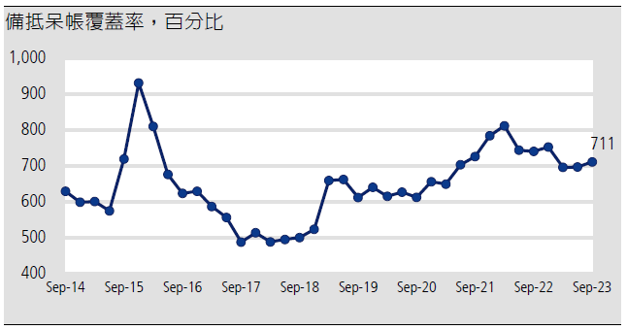
E.Sun – Financial Indicators
$$\text{Provision} \text{Coverage} \text{Ratio}=\frac{\text{Provision} \text{for} \text{Bad} \text{Debts} }{ \text{(}\text{NPL}\text{) }\text{Balance} ​}×100\%$$
data ：TEJ
From the chart, it can be observed that:
Over the years, E.Sun Bank has demonstrated consistent performance in both loan loss reserves and the non-performing loan (NPL) ratio, with a coverage ratio of 711% in 1Q23. A high loan loss reserve coverage ratio is generally considered a positive indicator of credit risk management, signaling that the bank has strong preventive and coping capabilities against potential losses. Conversely, a low coverage ratio may suggest that the bank may not be adequately prepared to address potential credit risks, requiring careful risk assessment and reinforcement of risk management measures. Therefore, it can be concluded that while E.Sun may not be deemed outstanding in this credit risk management indicator, its stable performance is likely to attract investors.

Slide 16
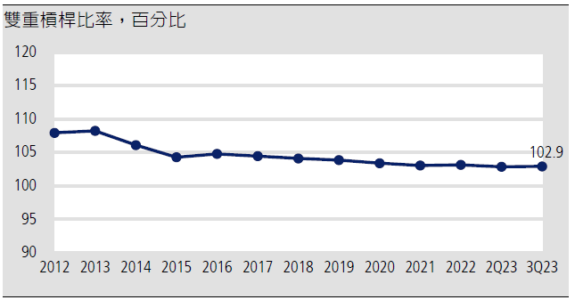
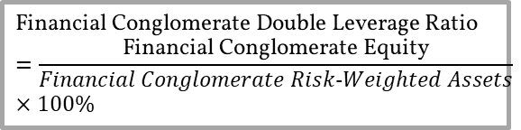
E.Sun – Financial Indicators
$$\text{Financial} \text{Conglomerate} \text{Double} \text{Leverage} \text{Ratio}=\frac{\text{Financial} \text{Conglomerate} \text{Equity}}{Financial Conglomerate Risk−Weighted Assets​}×100\%$$
data ：TEJ
From the chart, it can be observed that:
In the Taiwanese financial industry, the average double leverage ratio is around 115%, while E.Sun ratio is 102.9%, noticeably below the industry average. A high double leverage ratio for financial conglomerates may imply that, relative to their net worth, they possess a greater amount of risk-weighted assets, potentially increasing their risk exposure. On the other hand, a low double leverage ratio indicates that the financial conglomerate has a relatively smaller amount of risk-weighted assets in proportion to its net worth, suggesting a more conservative financial position. Therefore, it can be concluded that E.Sun exhibits a stable and favorable performance in this credit risk management indicator.

Slide 17
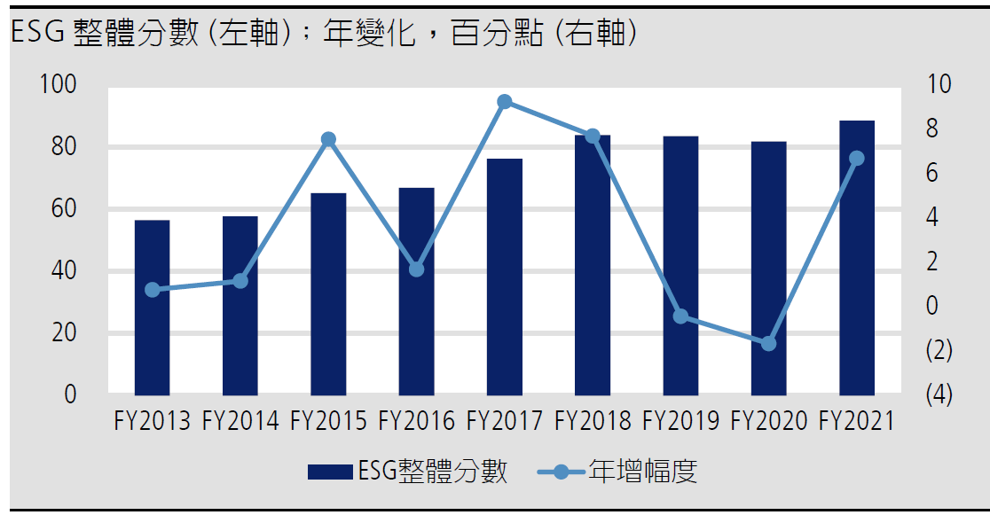
E.Sun – Financial Indicators
data ：Refinitiv、凱基
From the chart, it can be observed that:
In terms of ESG ratings, E.SUN exhibits a stable and gradual upward trend, with a notable increase in 2021 compared to 2020.

Slide 18
Compare – E.Sun v.s. Yuanta
Yuanta :
After-tax net profit growth rate expanded to 35%.
After-tax profit increased by 48%.
Provision for bad debts decreased by 89%.
The percentage of non-performing loans to total loans has gradually decreased, reaching only 3% in 1Q23.
Yuanta's allowance for doubtful accounts coverage ratio has been gradually increasing, reaching 4861% in 1Q23.
ESG score showed a substantial annual increase in 2021.
E.Sun :
After-tax net profit was NT$5.34 billion, representing a 17% annual increase and a 19% quarterly increase.
In 3Q23, E.SUN Bank's net interest margin remained unchanged from the previous quarter at 1.3%.
The non-performing loan ratio for E.SUN Bank has been maintained at a certain level, standing at 17% in 1Q23. While the value is not very low, it demonstrates a relatively stable performance.
E.SUN Bank's provision coverage ratio and non-performing loan ratio have remained stable, reaching 711% in 1Q23.
Compared to the average in the Taiwanese financial industry, E.SUN Bank has a significantly lower double leverage ratio.
ESG score showed a a stable and gradual upward trend.

Slide 19
Conclusion
I will recommend Yuanta from risk management perspective :
The analysis of Yuanta's financial indicators reveals a robust performance in managing credit risks. The provision for bad debts decreased significantly by 89%, and the percentage of non-performing loans to total loans showed a gradual decrease, reaching only 3% in 1Q23. Yuanta's allowance for doubtful accounts coverage ratio has been steadily increasing, reaching an impressive 4861% in 1Q23, indicating a strong ability to prevent and respond to potential losses.Moreover, Yuanta's diversified business portfolio, encompassing securities, banking, and other sectors, contributes to risk diversification, enhancing overall stability. The positive trajectory in ESG scores, with a substantial annual increase in 2021, suggests Yuanta's commitment to environmental, social, and corporate governance improvements, potentially attracting favor from ESG-oriented investors.Considering these factors, Yuanta demonstrates a solid foundation in risk management, diversified business operations, and positive ESG developments, making it a prudent choice for investment.

